Slide 1








FRESHIFY
Freshness beyond borders

Slide 2
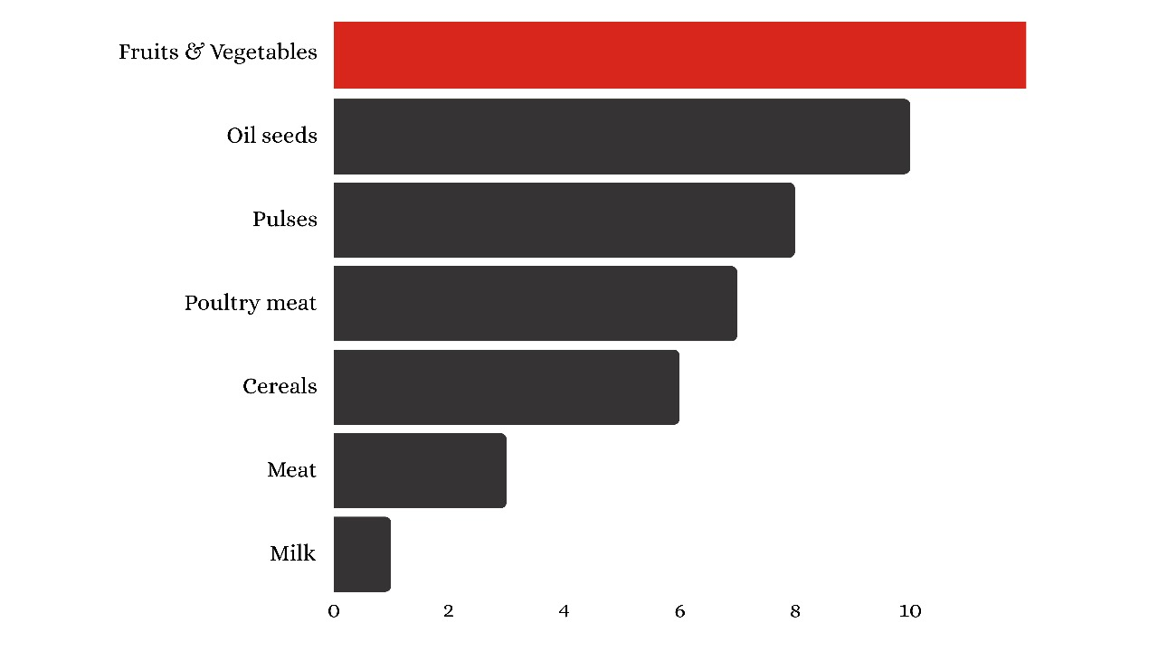
FOOD PRODUCT WASTE
https://economictimes.indiatimes.com

Slide 3


PROBLEM STATEMENT
Losses in Business and Food Waste: Businesses suffer financial losses and contribute to food waste due to the misjudged shelf life of produce
Misjudgments in the fruit and vegetable transportation industry lead to the overestimation of product freshness, resulting in both economic and environmental consequences.

Slide 4


EXISTING SOLUTION:
Cold Food Storage (CFS) Solution: Involves controlling temperatures to mitigate ethylene gas production and preserve fruit quality, including prompt cooling to 14°C (58°F) and sanitation measures like hot water treatments.
Cons
High cost
Risk of Damage

Slide 5



PROPOSED SOLUTION
Tailored Ripening:
Utilize ethylene gas monitoring to adjust ripening based on destination.
Data-Driven Decisions:
Analyze data for tailored ripening, efficient routes, and delivery schedules.
Advanced Sensors:
Monitor ethylene levels, temperature, and humidity for precise control.

Slide 6
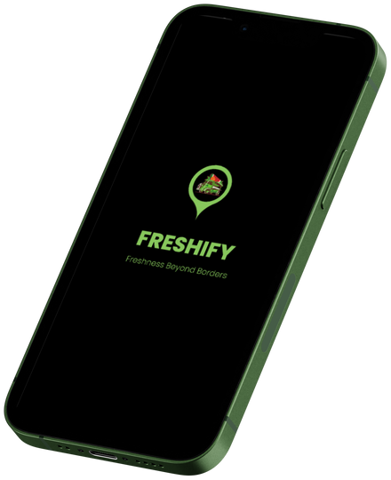






WORKFLOW
Delivery schedule
Freshness level
Prior delivery Hub
Freshify
Beacon
ML model
Controlled
Ventilation

Slide 7

Freshify
Ethylene gas sensor
ML model
Ventilation fan
Products in the
Freshify box
Controlled environment
for products
tailored for the user
Fins to control
ventilation

Slide 8
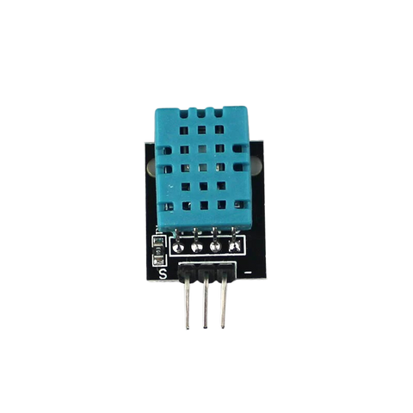

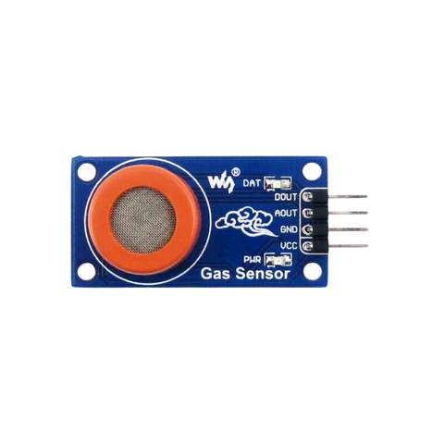
CIRCUIT DIAGRAM
DHT 11
GAS SENSOR
12V
5V

Slide 9
BUSINESS MODEL
We offer solutions to companies like NinjaCart, Zepto, CropIn, and AgroStar to reduce food waste and losses in the agricultural supply chain
Ethylene gas sensor
Rs. 150
Container box
Rs. 250
WiFi Module
Rs. 160
DHT - 11
Rs. 150
Battery
Rs. 20/ per box
Total
Rs. 730/ per box
Total for 100 box
Rs. 62000 / 100 box

Slide 10
Thank you

